Slide 1
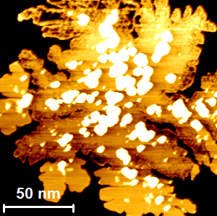
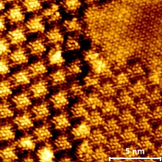
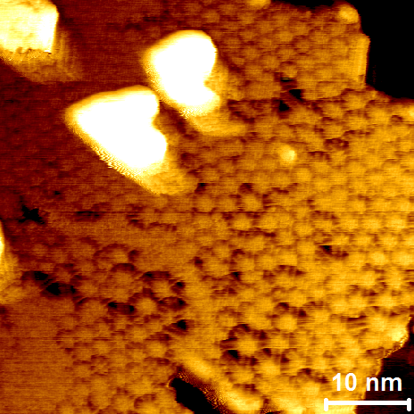
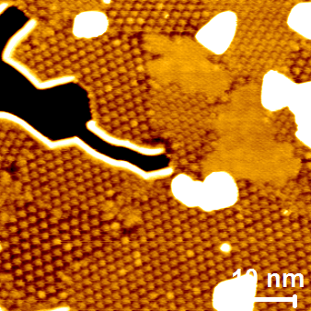
MoTe₂ as grown at 200°C
Annealing in
Te-flux
400°C
$$\sqrt{39}$$
450°C
$$2\sqrt{7}$$
$$2\sqrt{3}$$
$$2\sqrt{13}$$
$$\sqrt{39}$$

Slide 2
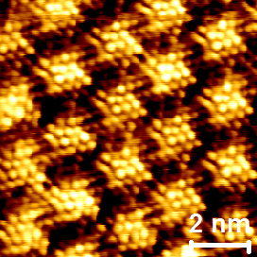
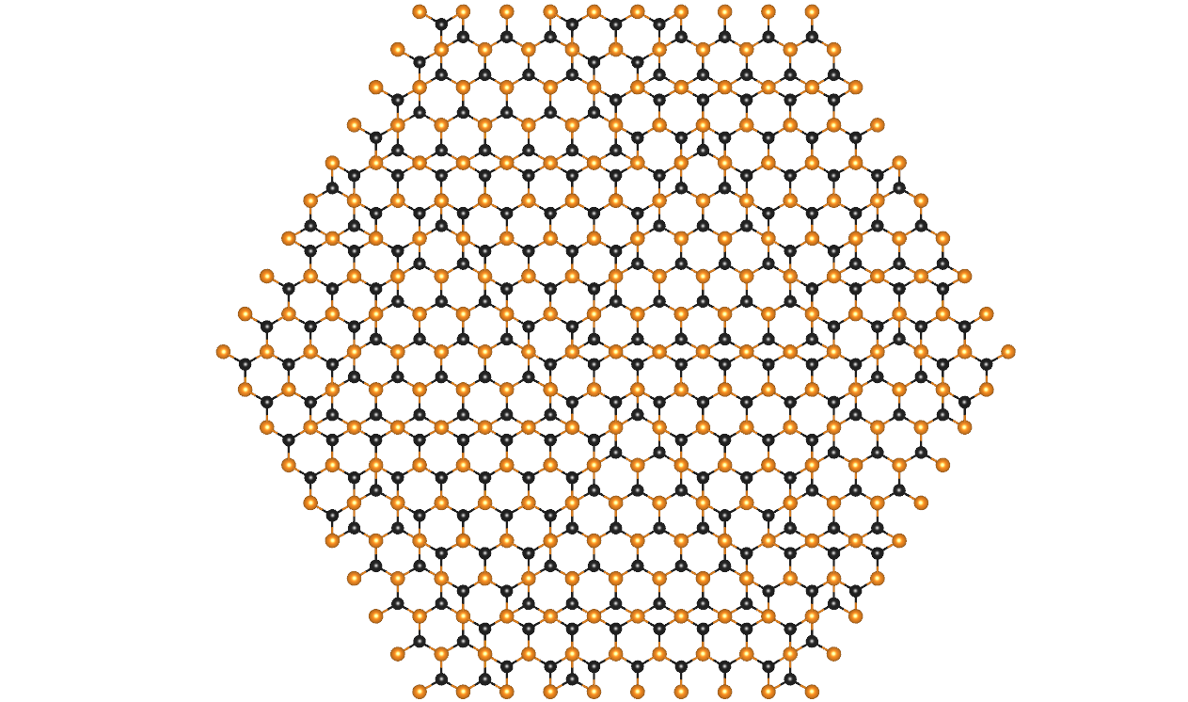
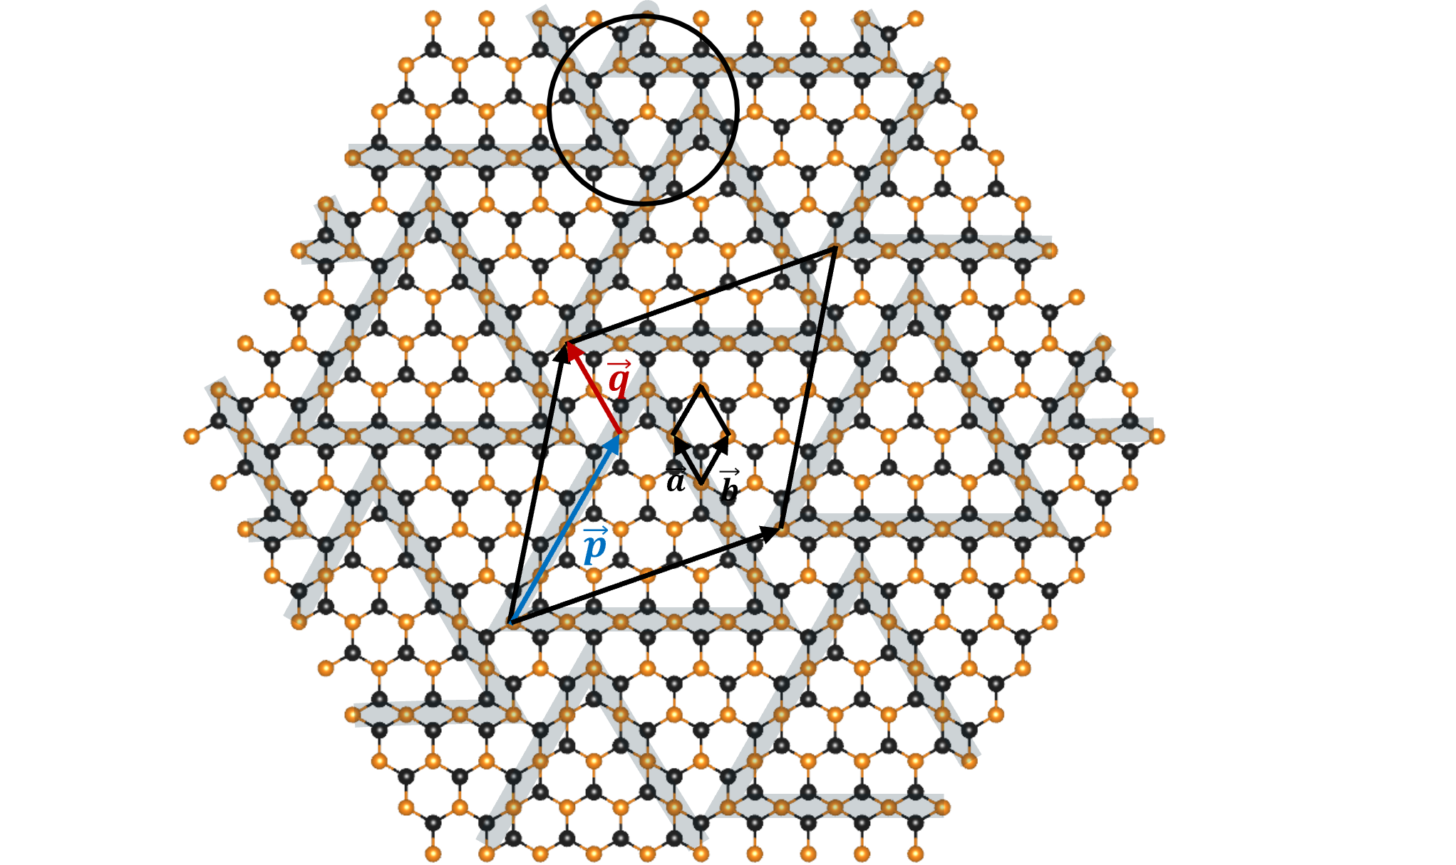
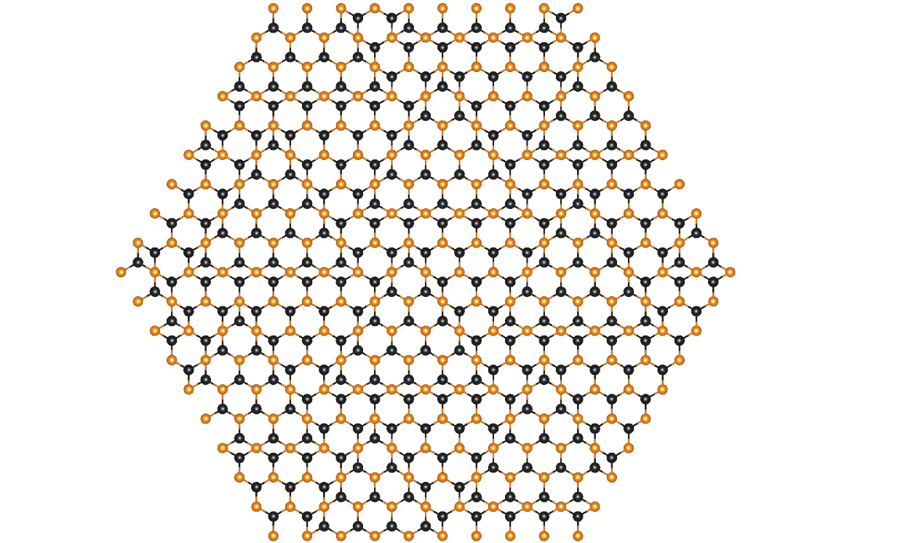
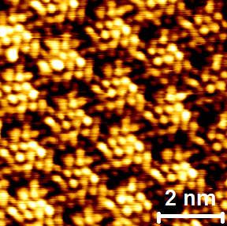
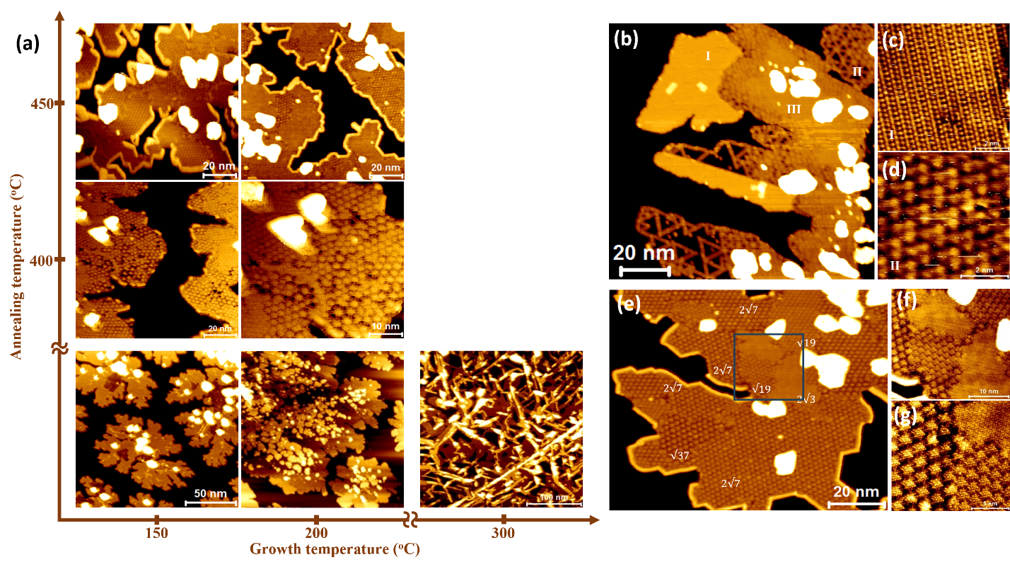
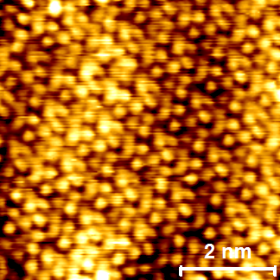
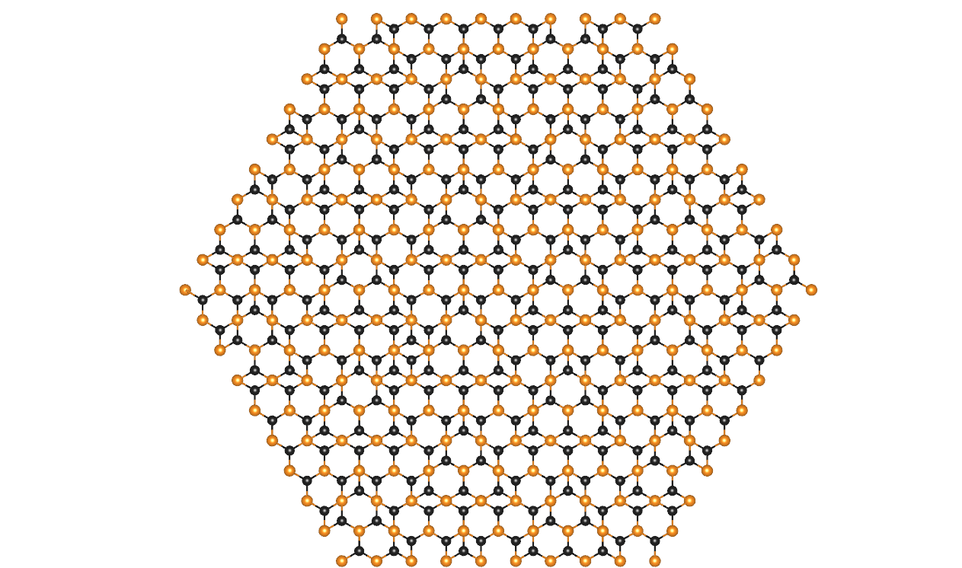
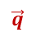
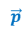

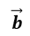
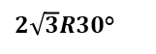
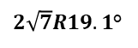
$$\sqrt{39}R16.1$$
(b)
$$\vec{q}$$
$2\sqrt{7}R19.1$°
$$\vec{a}$$
$$\vec{b}$$
$$\vec{p}$$
All the observed ordered phases can be constructed by the same q ( =2 a ) (i.e. offset between MTBs) and varying p (i.e. length of MTBs)
$2\sqrt{3}R30$°

Slide 3
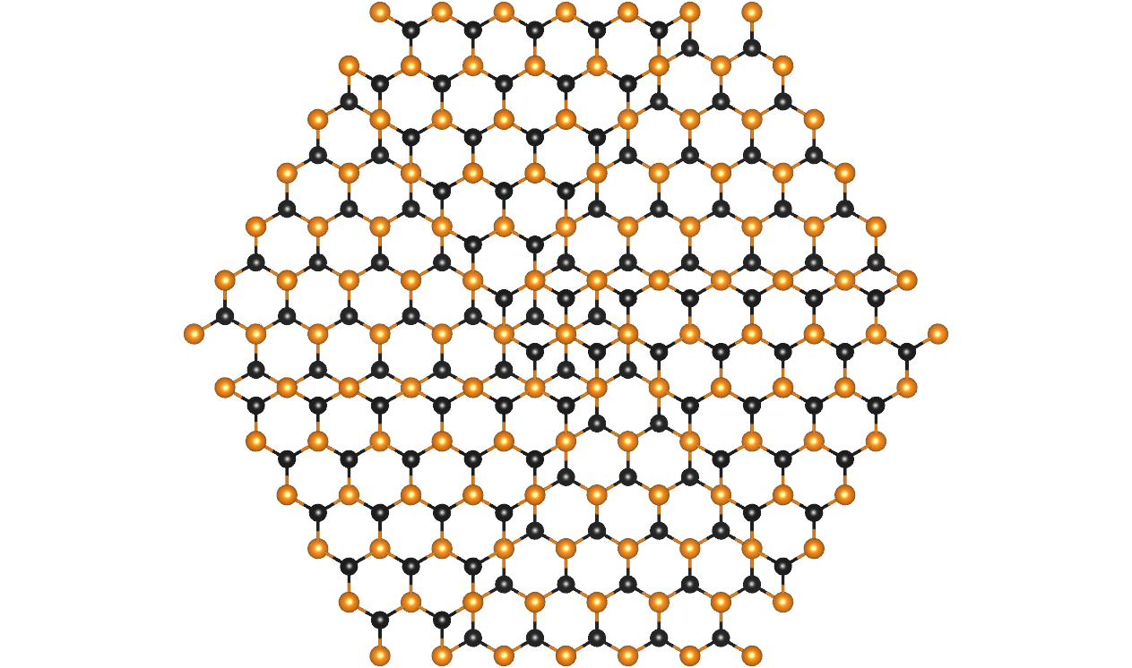
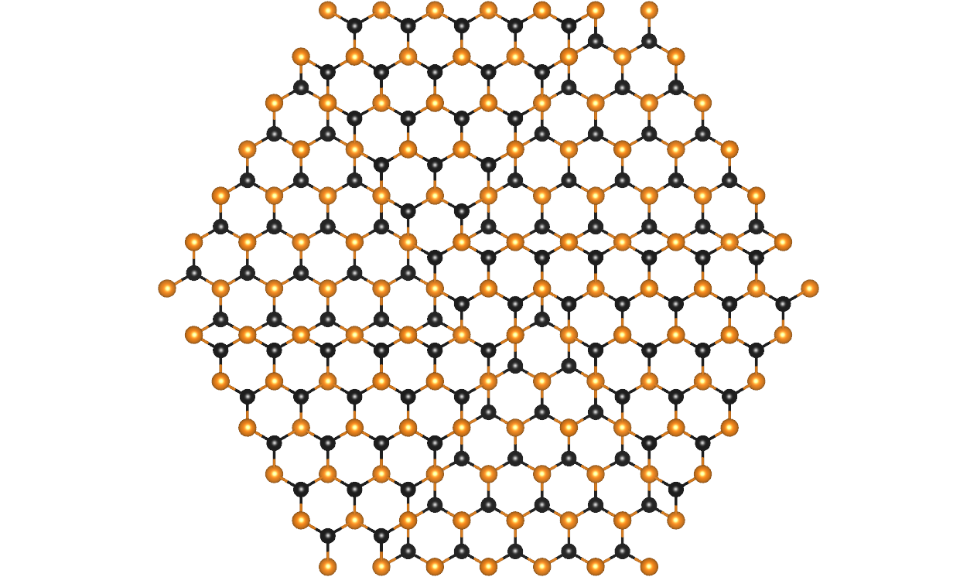
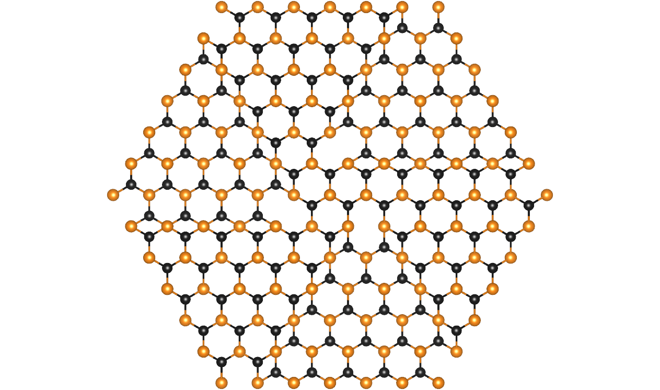
We have the following questions which you may help us with:
What exactly is the structure of the ‘vertices’, what is energetically preferred? Simple structural models for the same MTB arrangements are (the first one is probably not realistic)

Slide 4
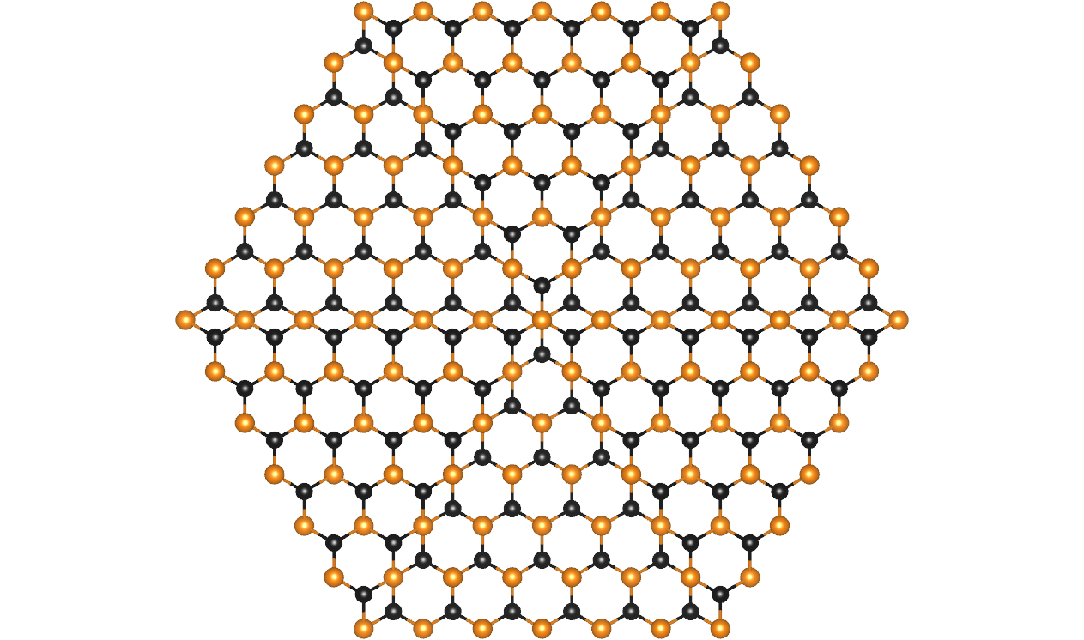
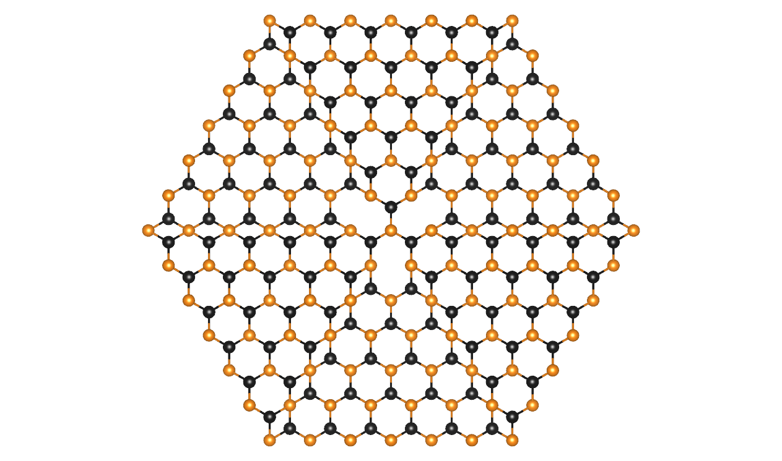
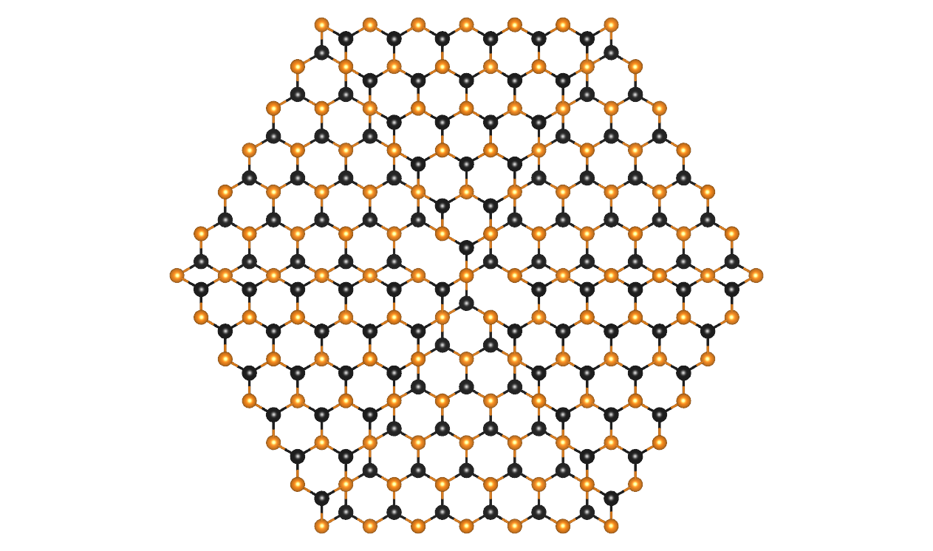
2. Why is the q=2a the preferred MTB offset? We can also construct reasonable structures with q=1a or 0a
q=0a:

Slide 5
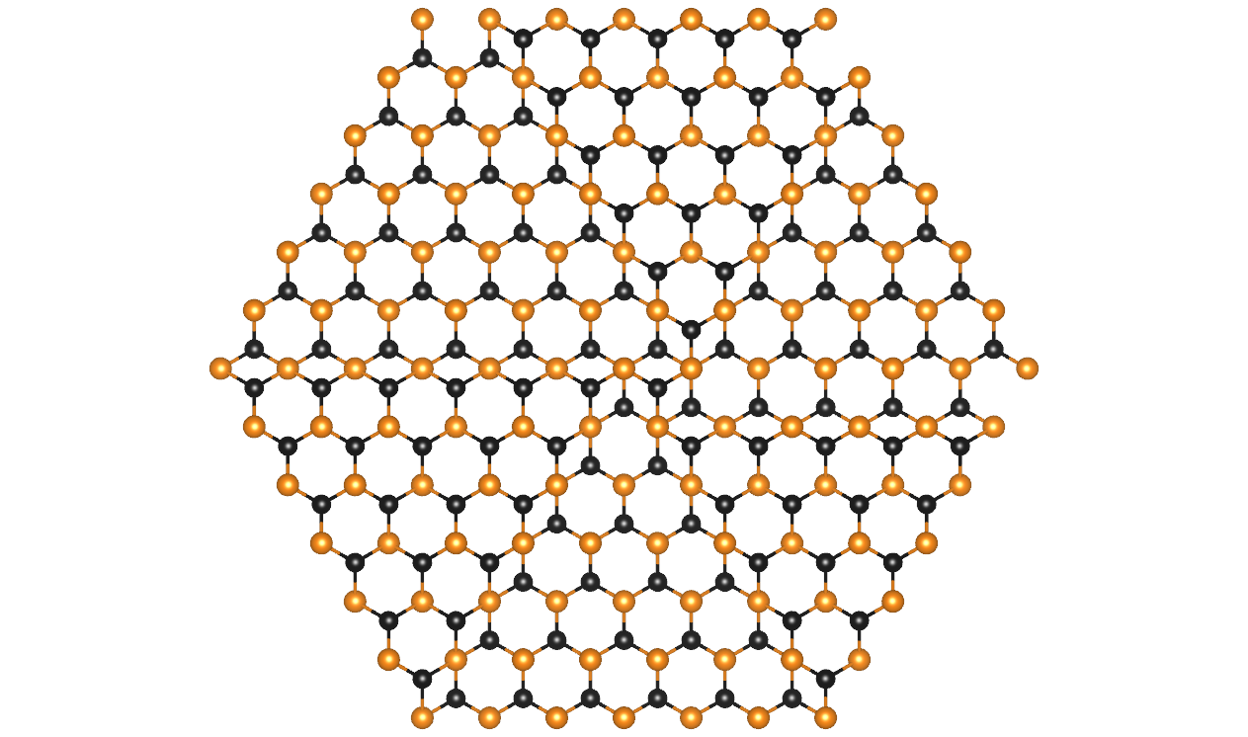
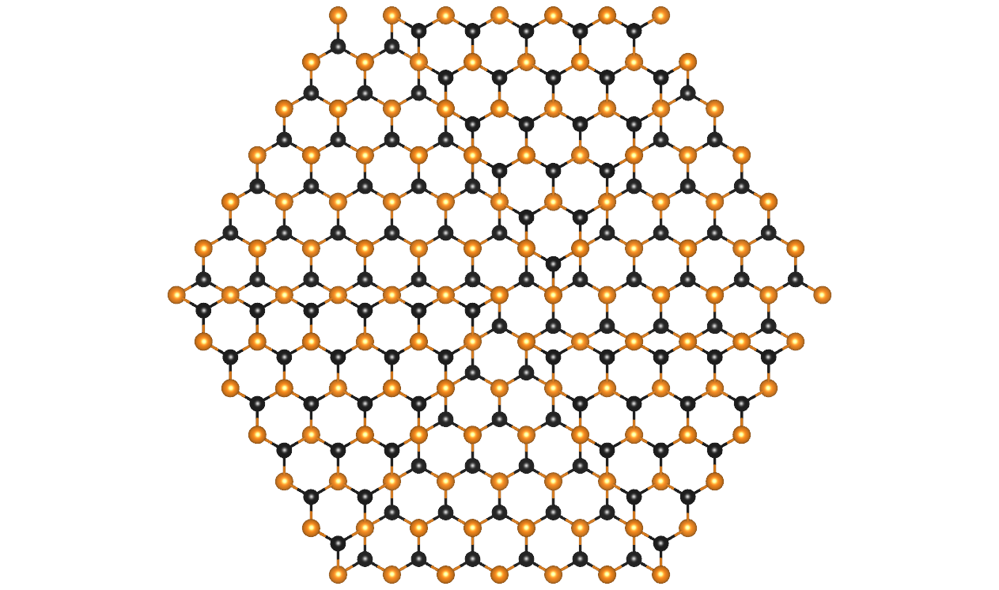
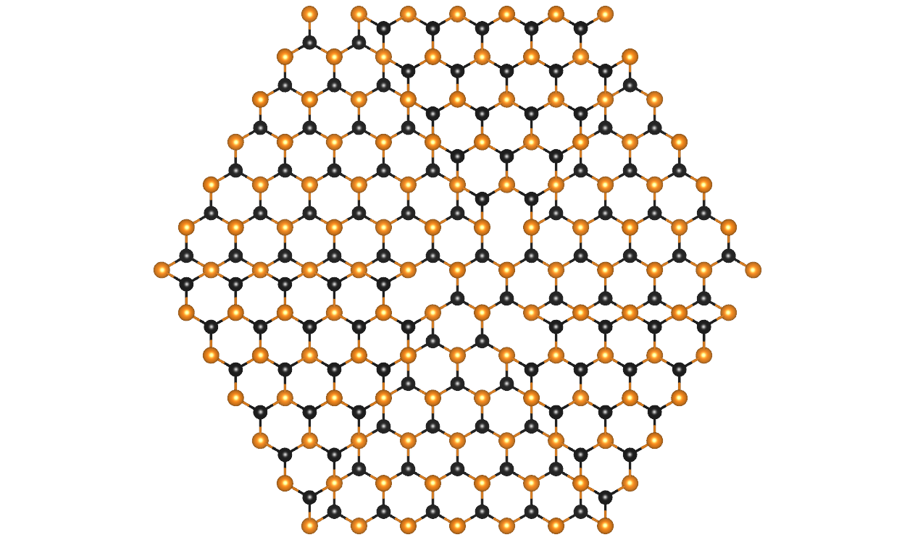
q=1a

